Slide 1
第9讲 概率检索模型

Slide 2
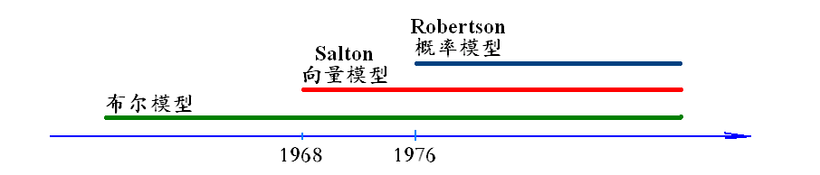
经典信息检索模型
布尔模型
向量空间模型
经典概率模型

Slide 3
布尔模型最大的问题
Boolean search: feast 盛宴or famine饥荒
Query 1: “standard user dlink 650” → 200,000 hits
Query 2: “standard user dlink 650 no card found”: 0 hits
a lot of skill 解决问题
AND gives too few;
OR gives too many
向量空间模型

Slide 4
向量空间模型
文档表示成向量，‌‌
查询也表示成向量，
‌‌两个向量之间的相似度：余弦相似度，‌‌内积相似度‌‌等等，‌‌
在向量表示中的‌‌词项权重计算方法，‌‌主要是‌‌tf-idf公式，‌‌
余弦相似度: 实际考虑 ‌‌tf,‌‌ idf‌‌以及文档长度三个因素‌

Slide 5
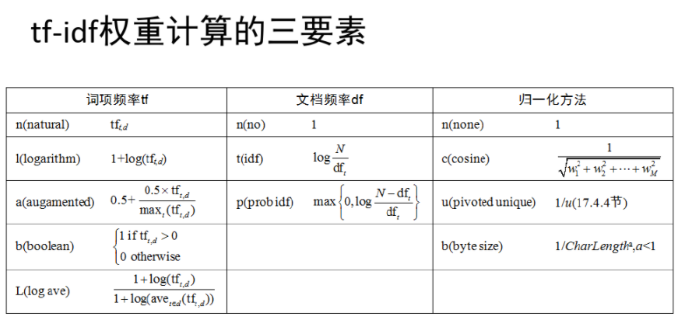
重要填空！

Slide 6
Why probabilities in IR?
User
Information Need
Query
Representation
Understanding
of user need is
uncertain
How to match?
Document
Representation
Uncertain guess of
whether document has relevant content
Documents
Probabilities provide a principled foundation for uncertain reasoning.
Can we use probabilities to quantify our search uncertainties?
Probabilistic methods are one of the oldest but also one of the currently hot topics in IR
Traditionally: neat 合理的ideas, but didn’t win on performance
It seems to be different now

Slide 7
目录
一、 Probability ranking principle PRP
二、 Binary Independence Model BIM
三、BM25

Slide 8
一、 Probability ranking principle PRP ---The document ranking problem
We have a collection of documents
User issues a query
A list of documents needs to be returned
Ranking method is the core of modern IR systems:
In what order do we present documents to the user? 相关度
We want the “best” document to be first, second best second, etc.
Idea: Rank by probability of relevance of the document w.r.t. information need
P(R=1|document_{i}, query)

Slide 9
Recall a few probability basics
For events A and B:
Bayes’ Rule
Prior
Posterior
Notes:
逻辑回归 逻辑斯蒂回归 对数几率回归

Slide 10
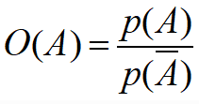
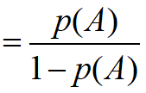
概率检索模型作为一个分类问题，
P(R=1|q,d)代表给定一个文档D对应的相关性概率，
P(R=0|q,d)代表给定一个文档D对应的不相关概率。
对于某个文档d来说，如果其属于相关文档子集的概率大于属于不相关文档子集的概率，我们就可以认为这个文档与用户查询q 是相关的。
即如果P(R=1|q,d) > P(R=0|q,d) ，我们可以认为文档与用户查询时相关的。
几率：

Slide 11
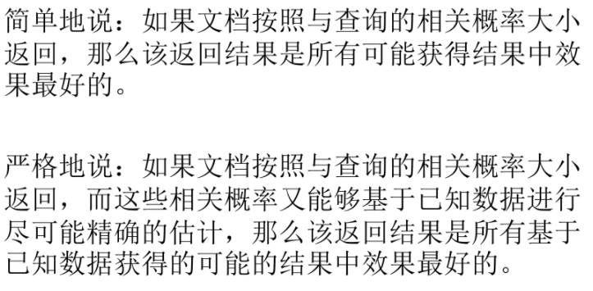
Probability ranking principle PRP
Theorem: Using the PRP is optimal, in that it minimizes the loss (Bayes risk) under 1/0 loss
Provable if all probabilities correct, etc. [e.g., Ripley 1996]

Slide 12
Probabilistic Retrieval Strategy
First, estimate how each term contributes to relevance
How do other things like term frequency and document length influence your judgments about document relevance?
Not at all in BIM
A more nuanced有细微差别的 answer is given by BM25
Combine to find document relevance probability
Order documents by decreasing probability
Notes:
In addition to the “document independence assumption” on previous slide, we have a “term independence assumption”: terms’ contributions to relevance are treated as independent events.
Okapi is one particular way of estimating probability given tf, df, and length.

Slide 13
二、 Binary Independence Model
BIM 二值独立概率模型
Traditionally used in conjunction with PRP
“Binary” = Boolean: documents are represented as binary incidence vectors关联向量 of terms
iff term i is present in document x.
“Independence”: terms occur in documents independently
Different documents can be modeled as the same vector
Bag of word

Slide 14
Binary Independence Model
Queries: binary term incidence vectors
Given query q,
for each document d need to compute p(R |q,d)
replace with computing p(R |q,x) where x is binary term incidence vector representing d
Interested only in ranking
Will use odds and Bayes’ Rule:

Slide 15
Binary Independence Model
Constant for a given query
Needs estimation
Using Independence Assumption:

Slide 16
Binary Independence Model
Since x_{i} is either 0 or 1:
Let
Assume, for all terms not occurring in the query (q_{i}=0)

Slide 17
 | document relevant (R=1) | document not relevant (R=0)
term present x_{i} = 1 | p_{i} | r_{i}
term absent x_{i} = 0 | (1 – p_{i}) | (1 – r_{i})

Slide 18
Binary Independence Model
All matching terms
Non-matching query terms
All matching terms
All query terms
Notes:
Put all terms in query into right product and then divide through by them in left product.
Just go straight from the top to the bottom line with a multiply and a divide.

Slide 19
Binary Independence Model
Constant for
each query
Only quantity to be estimated
for rankings
Retrieval Status Value:

Slide 20
Binary Independence Model [Robertson & Spärck-Jones 1976]
All boils down to computing RSV.
The c_{i} are log odds ratios
They function as the term weights in this model
So, how do we compute c_{i}’s from our data?
Notes:
Used to say: Linear Discriminant Function, because it is a linear function in terms of log probabilities, but maybe that’s too far afield for here, and is better discussed later

Slide 21
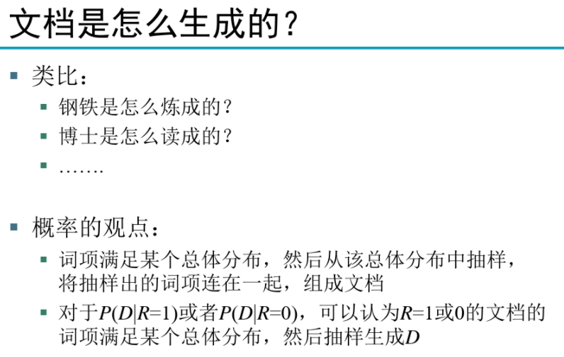

Slide 22
Graphical model for BIM – Bernoulli NB
p(x|R=1)
R
x_{i}
Binary
variables
Notes:
朴素贝叶斯

Slide 23
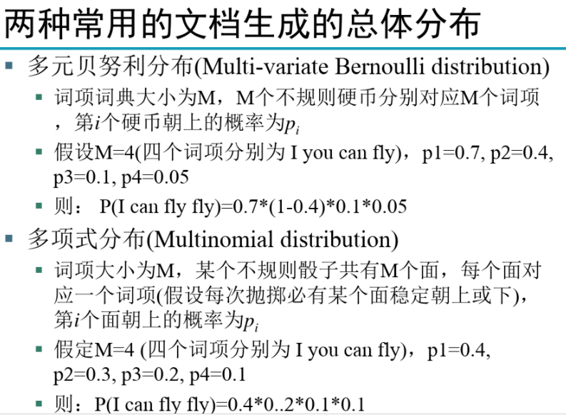

Slide 24
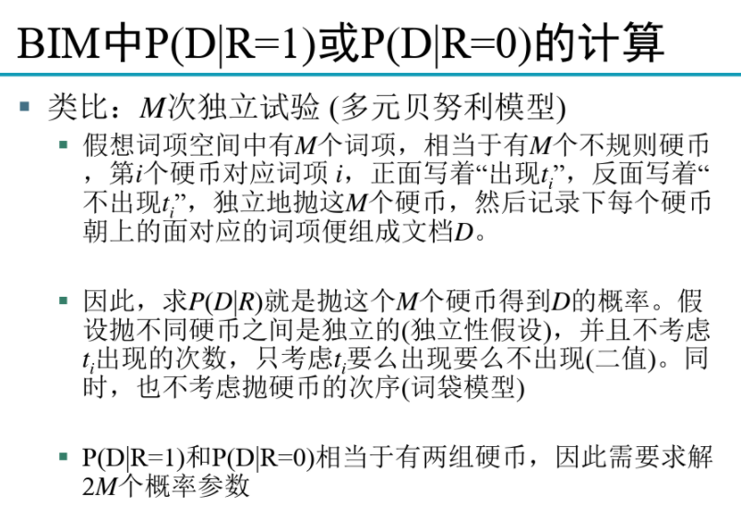

Slide 25
Binary Independence Model
Estimating RSV coefficients in theory
For each term i look at this table of document counts:
Estimates:
For now,
assume no
zero terms.
Remember
smoothing.
Notes:
p_i(1 – r_i) / r_i(1 - p_i) = denominators cancel out.
Log expression has numerators of p / (1 – p ) and denominators r / (1 – r).
Prabhakar wanted the add 0.5 explained. Here or elsewhere?
Log odds ratio. Add 0.5 to every expression

Slide 26
Estimation – key challenge
在实际中，很难知道相关文档有多少，所以假设 p_{i}=0.5
Inverse Document Frequency (IDF)
Spärck-Jones (1972)
A key, still-important term weighting concept

Slide 27
Estimation – key challenge
p_{i} (probability of occurrence in relevant documents) cannot be approximated as easily
p_{i} can be estimated in various ways:
constant (Croft and Harper combination match) – then just get idf weighting of terms (with p_{i}=0.5)
from relevant documents if you know some
Relevance weighting can be used in a feedback loop
proportional to prob. of occurrence in collection
Greiff (SIGIR 1998) argues for 1/3 + 2/3 df_{i}/N

Slide 28
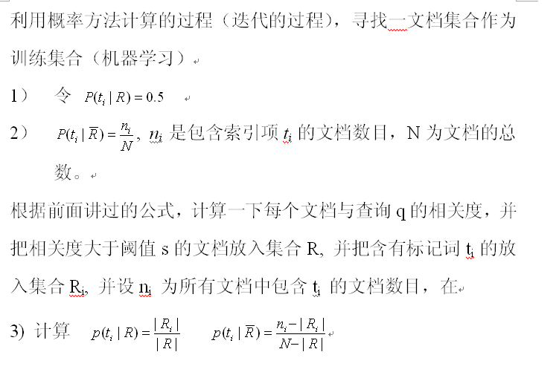
概率模型在实际中的计算方法 feedback loop

Slide 29
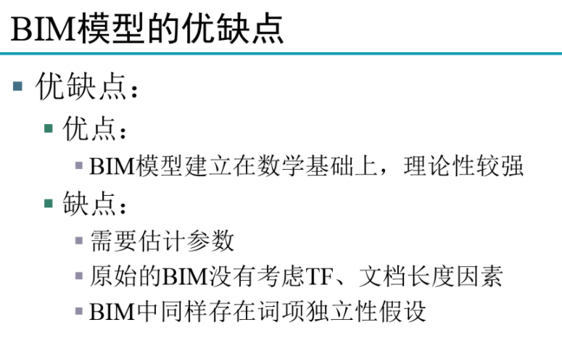

Slide 30
三、BM25
BM25是信息索引领域用来计算query与文档相似度得分的经典算法。
不同于TF-IDF，BM25的公式主要由三个部分组成：
query中每个单词t与文档d之间的相关性
单词t与query之间的相似性
每个单词的权重

Slide 31
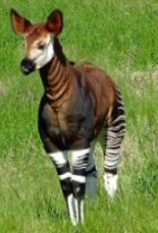
Okapi BM25 [Robertson et al. 1994, TREC City U.]
BM25 “Best Match 25” (they had a bunch of tries!)
Developed in the context of the Okapi system
Started to be increasingly adopted by other teams during the TREC competitions
It works well
Goal: be sensitive to term frequency and document length while not adding too many parameters
(Robertson and Zaragoza 2009; Spärck Jones et al. 2000)

Slide 32
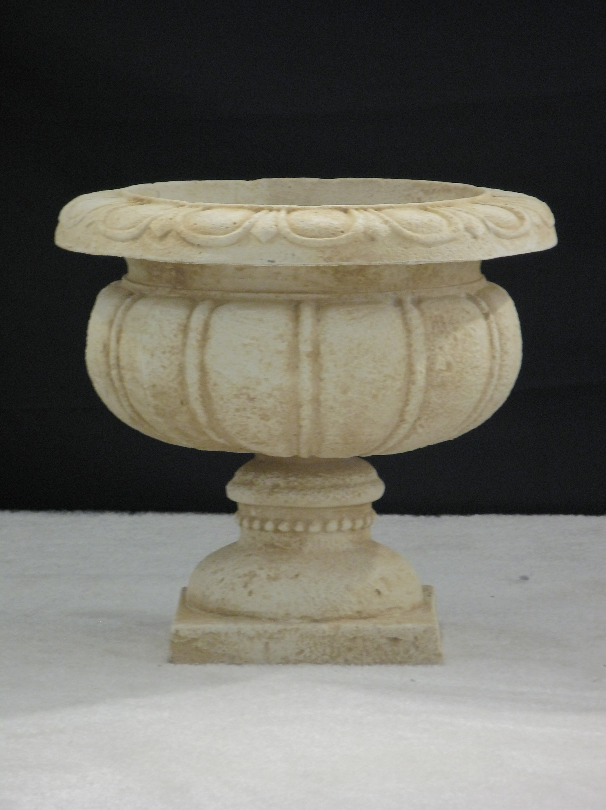
Generative model for documents
Words are drawn independently from the vocabulary using a multinomial distribution多项式分布
... the draft is that each team is given a position in the draft …
basic
team
the
given
draft
each
nfl
annual
team
of
draft
nfl
football
design
is
that
football
…

Slide 33

Generative model for documents
Distribution of term frequencies (tf) follows a binomial distribution – approximated by a Poisson
... the draft is that each team is given a position in the draft …
draft
…
…

Slide 34
Poisson distribution泊松分布
常见到的离散概率分布
描述单位时间内随机事件发生的次数k的概率分布
The Poisson distribution models the probability of k, the number of events occurring in a fixed interval of time/space,
K=0,1,2,
with known average rate λ , independent of the last event
参数λ是单位时间(或单位面积)内随机事件的平均发生次数

Slide 35
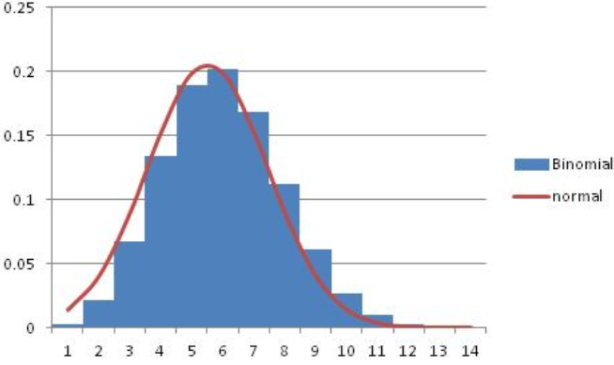
Poisson distribution
If T is large and p is small, we can approximate a binomial distribution with a Poisson where λ = Tp
Mean = Variance = λ = Tp.
Example p = 0.08, T = 20. Chance of 1 occurrence is:
Binomial
Poisson … already close

Slide 36
Poisson model
Assume that term frequencies in a document (tf_{i}) follow a Poisson distribution
“Fixed interval” implies fixed document length … think roughly constant-sized document abstracts
… will fix later

Slide 37
1-Poisson Model flaw缺陷
Is a reasonable fit for “general” words
Is a poor fit for topic-specific words
get higher p(k) than predicted too often
 |  | Documents containing k occurrences of word (λ = 53/650)
Freq | Word | 0 | 1 | 2 | 3 | 4 | 5 | 6 | 7 | 8 | 9 | 10 | 11 | 12
53 | expected | 599 | 49 | 2
52 | based | 600 | 48 | 2
53 | conditions | 604 | 39 | 7
55 | cathexis | 619 | 22 | 3 | 2 | 1 | 2 | 0 | 1
51 | comic | 642 | 3 | 0 | 1 | 0 | 0 | 0 | 0 | 0 | 0 | 1 | 1 | 2
Harter, “A Probabilistic Approach to Automatic Keyword Indexing”, JASIST, 1975
Notes:
Cathexis = the concentration of mental energy on one particular person, idea, or object (especially to an unhealthy degree).

Slide 38
Eliteness精英 (“aboutness”)
Model term frequencies using eliteness
What is eliteness?
Hidden variable for each document-term pair, denoted as E_{i} for term i
Represents aboutness: a term is elite in a document if, in some sense, the document is about the concept denoted by the term
Eliteness is binary
Term occurrences depend only on eliteness…
… but eliteness depends on relevance

Slide 39
Elite terms
Text from the Wikipedia page on the NFL draft showing elite terms
The National Football League Draft is an annual event in which the National Football League (NFL) teams select eligible college football players. It serves as the league’s most common source of player recruitment. The basic design of the draft is that each team is given a position in the draft order in reverse order relative to its record …

Slide 40
回顾： Graphical model for BIM – Bernoulli NB
R
x_{i}
Binary
variables

Slide 41
Graphical model with eliteness
R
E_{i}
Binary
variables
tf_{i}
Frequencies (not binary)
Notes:
Simple topic model … if you know other topic models like LDA, you might think of other ways of doing this. Here, the model directly boosts the term frequency of a bunch of words. Generative language model.

Slide 42
Retrieval Status Value
Similar to the BIM derivation, we have where and using eliteness, we have:

Slide 43
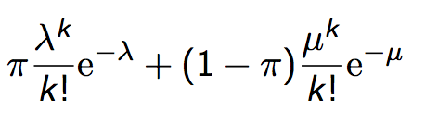
2-Poisson model
The problems with the 1-Poisson model suggests fitting two Poisson distributions
In the “2-Poisson model”, the distribution is different depending on whether the term is elite or not
where π is probability that document is elite for term
but, unfortunately, we don’t know π, λ, μ

Slide 44
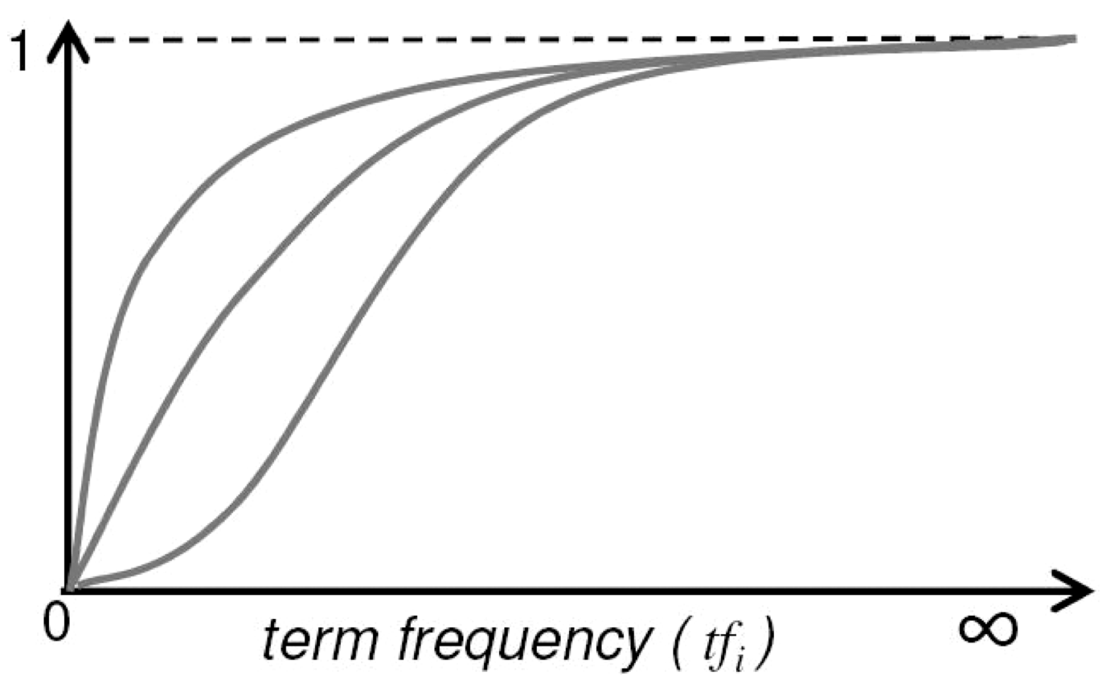
Let’s get an idea: Graphing for different parameter values of the 2-Poisson
Notes:
Concave upper two curves are for more “realistic” parameter values, so we want to approximate those ones not bottom ones.

Slide 45
Qualitative properties
.
increases monotonically with tf_{i}
… but asymptotically渐近地approaches a maximum value as
[not true for simple scaling of tf]
… with the asymptotic limit being
Weight of eliteness feature
Notes:
渐近地;

Slide 46
Approximating the saturation function
Estimating parameters for the 2-Poisson model is not easy
… So approximate it with a simple parametric curve that has the same qualitative properties

Slide 47
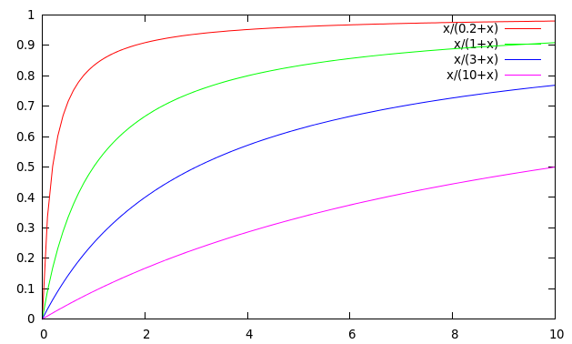
Saturation function
For high values of k₁, increments in tf_{i} continue to contribute significantly to the score
Contributions tail off quickly for low values of k₁
Notes:
K1=0.2 ,1,3

Slide 48
“Early” versions of BM25
Version 1: using the saturation function
Version 2: BIM simplification to IDF
(k₁+1) factor doesn’t change ranking, but makes term score 1 when tf_{i} = 1
Similar to tf-idf, but term scores are bounded 有边界
Notes:
But still don’t model document length

Slide 49
Why is BM25 better than VSM tf-idf?
Suppose your query is [machine learning]
Suppose you have 2 documents with term counts:
doc1: learning 1024; machine 1
doc2: learning 16; machine 8
tf-idf: log₂ tf * log₂ (N/df)
doc1: 11 * 7 + 1 * 10 = 87
doc2: 5 * 7 + 4 * 10 = 75
BM25: k₁ = 2
doc1: 7 * 3 + 10 * 1 = 31
doc2: 7 * 2.67 + 10 * 2.4 = 42.7

Slide 50
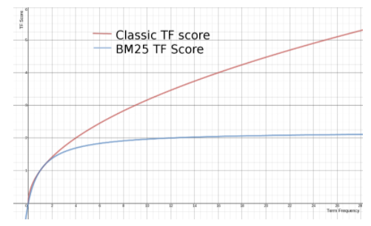
传统的TF值理论上是可以无限大的。而BM25与之不同，它在TF计算方法中增加了一个常量k，用来限制TF值的增长极限
BM25的TF Score会被限制在0~k+1之间

Slide 51
Document length normalization
Longer documents are likely to have larger tf_{i} values
Why might documents be longer?
Verbosity: suggests observed tf_{i} too high
Larger scope: suggests observed tf_{i} may be right
A real document collection probably has both effects
… so should apply some kind of partial normalization

Slide 52
Document length normalization
Document length:
avdl: Average document length over collection
Length normalization component
b = 1 full document length normalization
b = 0 no document length normalization
Notes:
Starts second half!

Slide 53
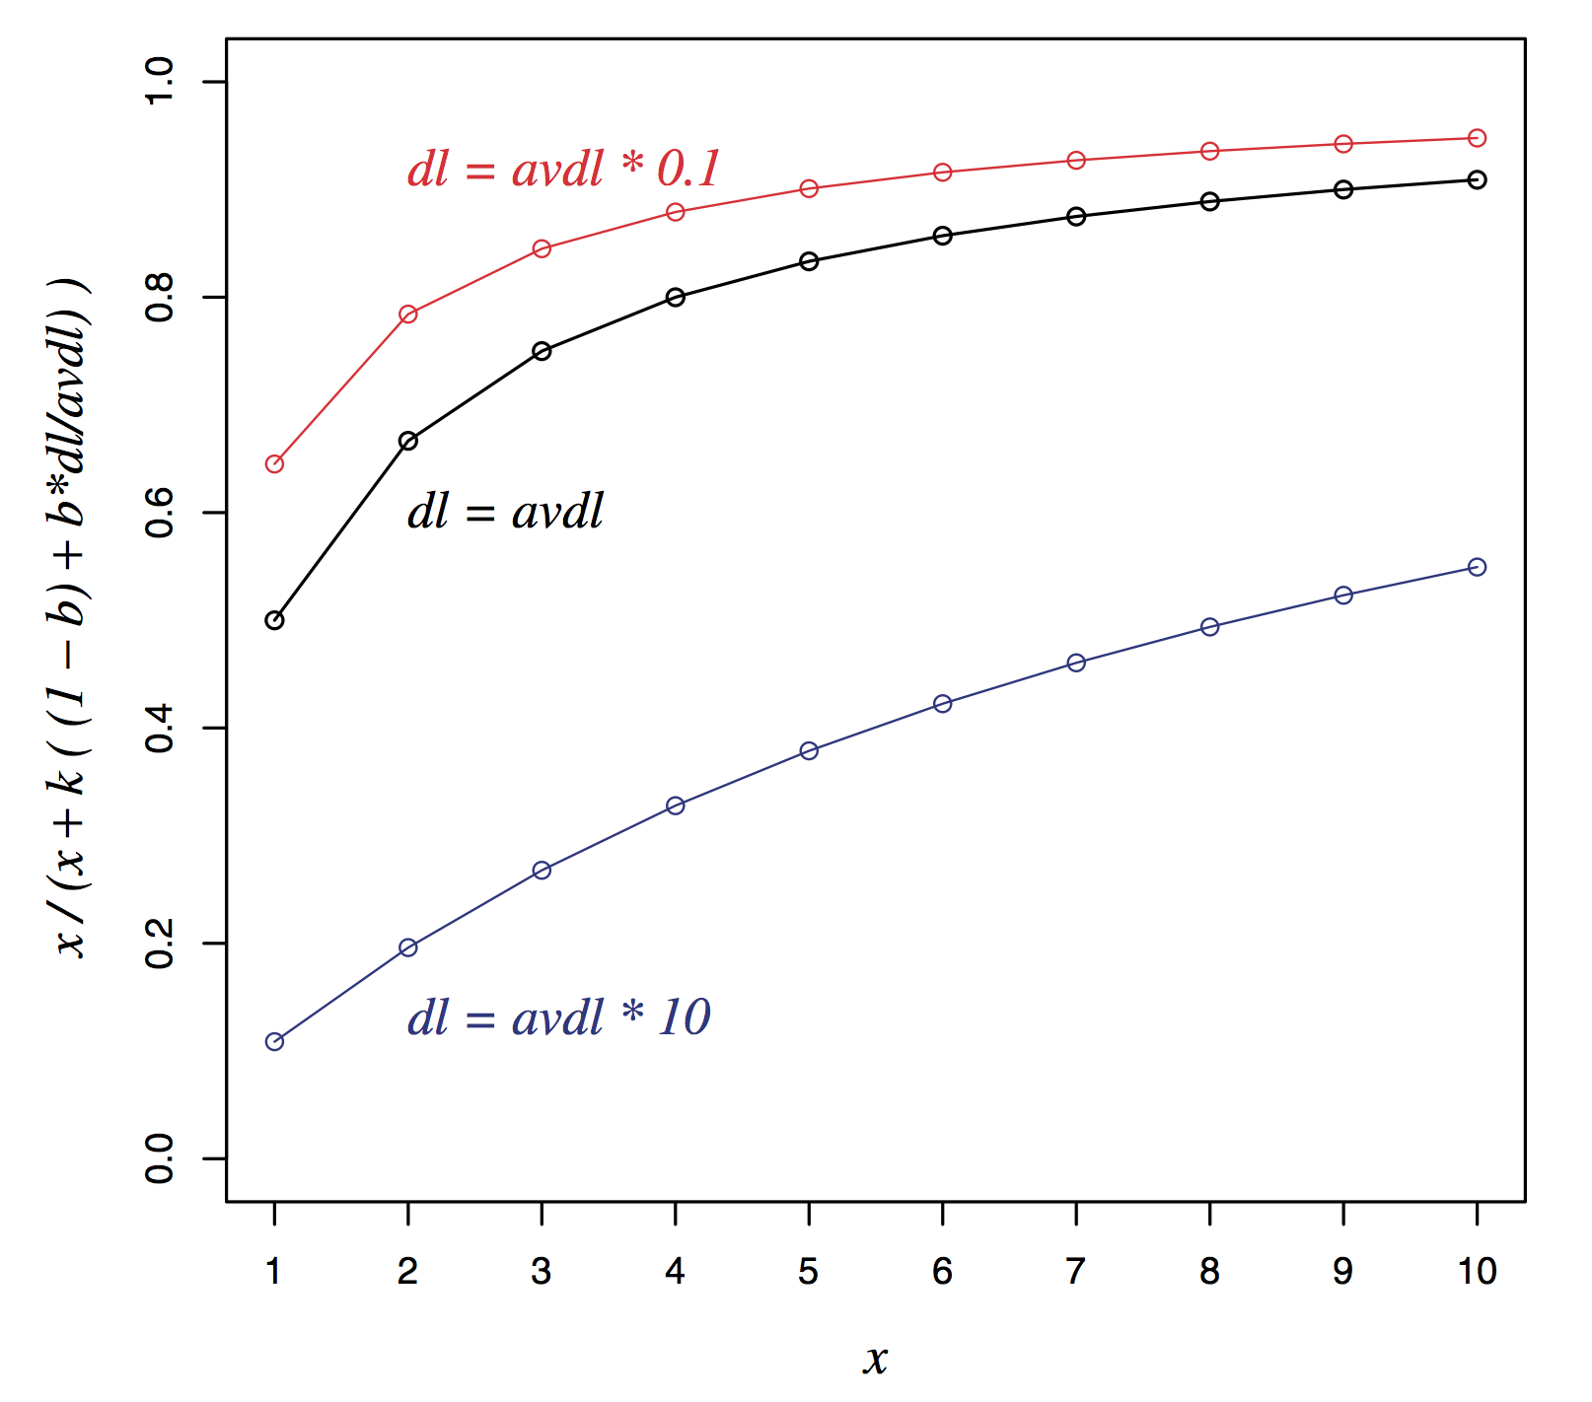
Document length normalization

Slide 54
Okapi BM25
Normalize tf using document length
BM25 ranking function

Slide 55
Okapi BM25
k₁ controls term frequency scaling
k₁ = 0 is binary model; k₁ large is raw term frequency
b controls document length normalization
b = 0 is no length normalization; b = 1 is relative frequency (fully scale by document length)
Typically, k₁ is set around 1.2–2 and b around 0.75

Slide 56
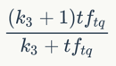
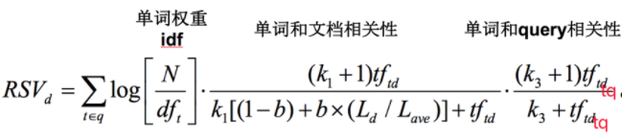
如果查询很长，那么对于查询词项也可以采用类似的权重计算方法。
tf_{tq}是词项t在查询q中的权重。
k3 是另一个取正值的调优参数，用于对查询中的词项tq 频率进行缩放控制。

